Slide 1
Nintex-DOCUSIGN Connector
Authentication
Connection
Retrieving user Information

Slide 2
Prerequisites
1. Must have a DocuSign sandbox (developer) account.
2. Must have went through this compiled DocuSign Oauth 2.0 document. (see original)
3. Must have good knowledge of DocuSign and Nintex Workflow.
Note: DocuSign Oauth 2.0 document are about what need to be done to get Oauth 2.0
get connected to any app. These steps are then implemented in
using open API specification in json format and most of things
automatically by nintex.

Slide 3
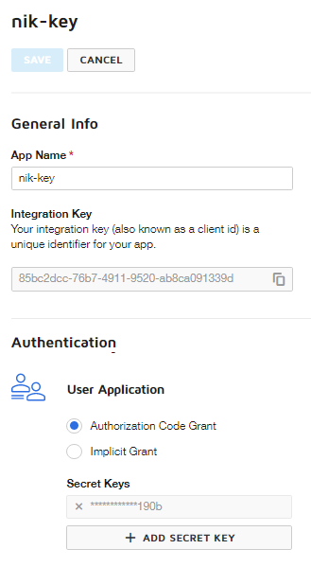
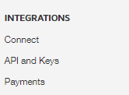

Step 1: go to https://admindemo.docusign.com.
Go to API and Keys under INTEGRATIONS
from left side navbar.
Next in new view opened on the left
click ADD APP/INTEGRATION KEY
On next screen configure
1. Under General Info add the App Name.
2. Under Authentication select Authorization Code Grant and click ADD SECRET KEY.
3. Copy the Integration Key and Secret Key.

Slide 4
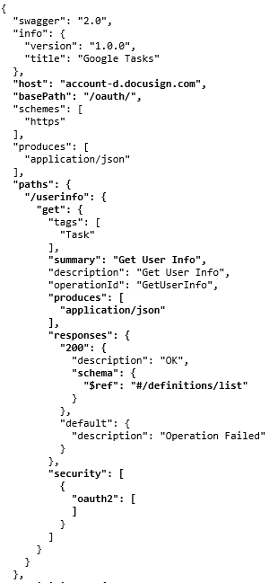
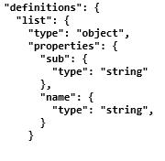
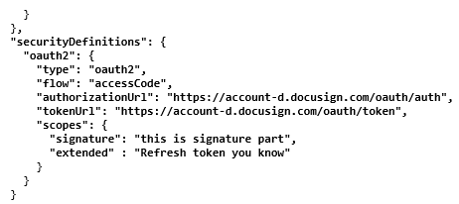
Step 2: Define Oauth2 authentication (Open -API Specification)
1
2
3
4

Slide 5
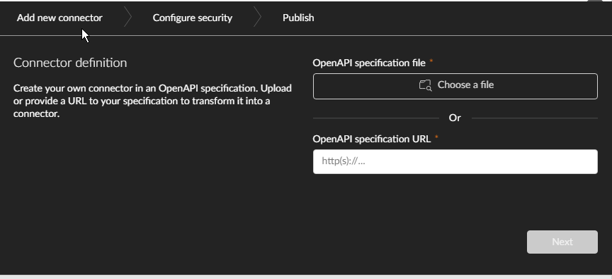
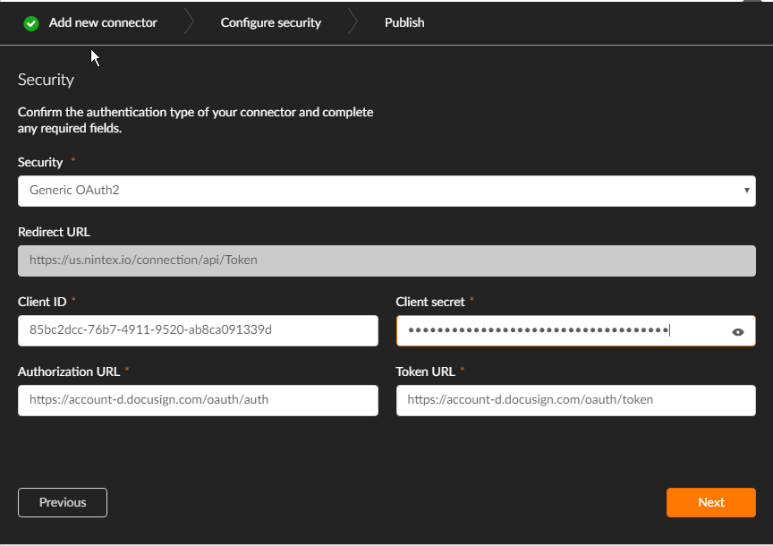
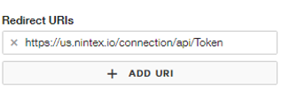
Step 3: Create Custom Connector
4
1. Go to nintex dashboard.
2. Go to Xtensions.
3. Click Add Xtensions.
4. Add open Api json file just created in step 2.
5. Next add Integrator key (Client ID)
and secret.
6. Copy the redirect url.
Go back to
https://admindemo.docusign.com.
and edit the integration key we just
created in step 1 and add the redirect url.
7. Publish the connector.
5
6

Slide 6
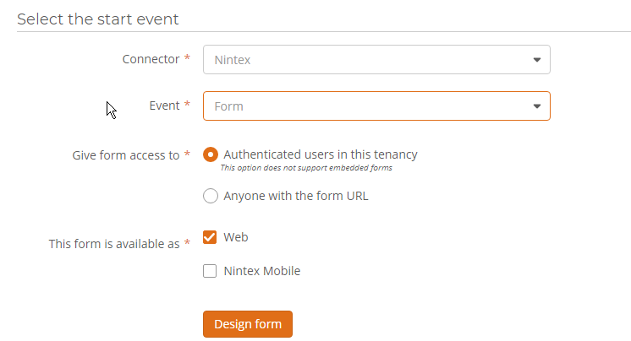
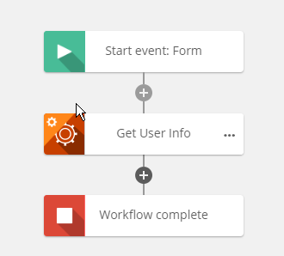
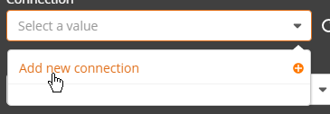
Step 4: Create Workflow
1
1. Edit the start event. To be of form type just for testing.
Add any control you like in design form as we only want
to deal with starting the workflow.
2. Add Get User Info from action panel. It is the operation
mentioned in Open API json file we created in step 2.
3. Click this action in workflow and on left menu that opens
click add connection.
A new window is shown up as
shown in next slide.
2
3

Slide 7
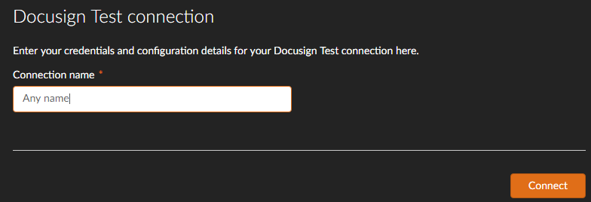
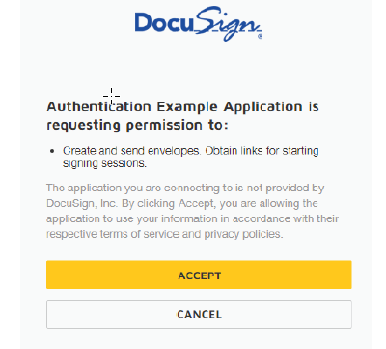
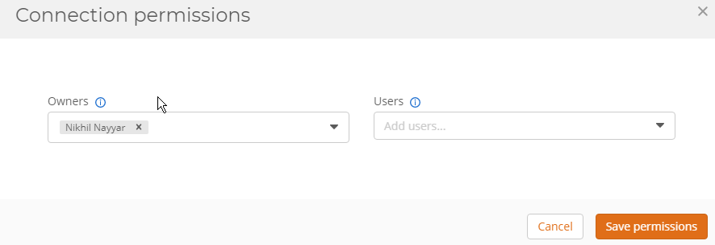
4
4. Add any name. What happens is in back the
nintex automatically used the credentials we
provided earlier and creates connection.
5. The specified user whose DocuSign integrator key
Was supplied is asked for permission. Here I am notified
Straightforward in the flow of work. Accept it.
6. In next window click save permission to save connection.
5
6

Slide 8
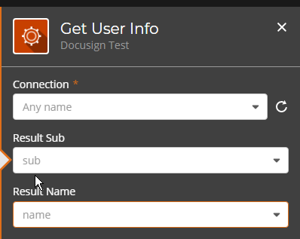
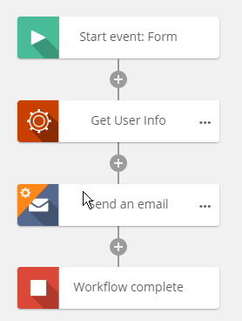
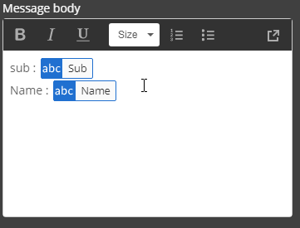
7
7. Click the Get User Info action in workflow and
on left menu that opens add to text variables named
sub and Name for response fields we specified in Open API
Json in step 2. We will use these return values for testing by
sending them to a recipient through email.
8. Add email action in workflow
Add recipient email (nikhilnayyar002@gmail.com).
Create message with body shown:
9. Publish the workflow all done. Manual start it.
8
8

Slide 9
References
https://developers.docusign.com/esign-rest-api/guides/authentication/oauth2-code-grant
https://help.nintex.com/sdk/Content/01_GetStarted/PRC_01Create_Connector.htm?TocPath=Add%20a%20custom%20connector%20to%20Nintex%20Workflow%20Cloud|_____0
https://help.nintex.com/sdk/Content/01_GetStarted/NAV_Get_Started.htm?TocPath=Build%20your%20first%20connector|_____0
https://help.nintex.com/sdk/Content/02_BuildOpenAPI/02_Authentication/PRC_03OAuth.htm?TocPath=Authenticate|_____3
https://editor.swagger.io/

